Slide 1
A Machine Learning Approach for Instance Matching Based on Similarity Metrics(ISWC,2012, S Rong, X Niu , Shanghai Jiao Tong University)

Slide 2
Related work:
1. Record Linkage: a classical problem in the area of database.
Goal: is to determine the pairs of records that are associated with the same entity across various data sets.
Difference with instance matching:
  The number of fields in a record linkage problem is usually quite small.
  An instance consists of some property-value descriptions

Slide 3
Related work:
2. two existing instance matching method and corresponding limitation:
  Domain specific: only work well in a specific domain.
  Property matching dependent: only focus on the properties of instances, emitting some important information existed in their values.
  Other papers improve the efficiency of instance matching: limits the number of candidate matching pairs by triangle equation and reverted indexing…

Slide 4
Contributions
Utilize values of non-matching properties.
Propose a novel approach which is independent of property matching with high accuracy.
Present a transfer learning model to help match instances.

Slide 5
Solution
1. raise the problem of instance matching:
  Introduce that the data sources of Linked Open Data are increasing rapidly.
  There is an urgent demand to provide owl:sameas links from existed data sources to new added data sources.
  Explain why traditional methods can not work well in the LOD scenario by an example. (mainly discuss the drawback of property matching method)

Slide 6
Solution
2. Formalize the problem step by step.
  Definition 1 (Instance Matching): Given two data sources, find the set (a,b) represents the same instance.
  Definition 2 (Instance Matching as Binary Classification): find a classifier to judge whether (a,b) represents the same object.
  Definition 3 (Similarity Vector of Instance Pairs): Feather vector of an instance pair:{v1,v2,…,vn} vi=di(a,b)

Slide 7
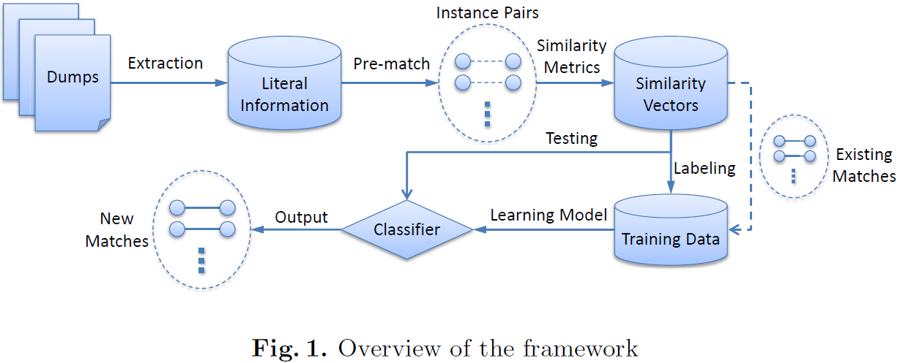
Solution
3. Describe the system framework:

Slide 8
Solution
4.Feather extraction:
  Literal information extraction
  Similarity metric functions
4.1 Literal information extraction
  L_{label}
  L_{property}
  L_{value:} L_{single} L_{short} L_{long}
  L_{date} L_{number} L_{link}

Slide 9
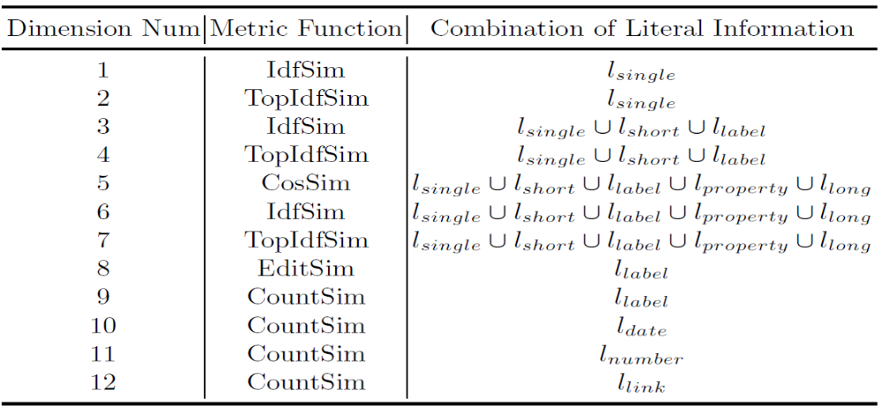
Solution
4.2 Similarity metric functions: 12-dimensional similarity vector for each instance pair.

Slide 10
Solution
5.machine learning algorithm:
  Basic learning model: decision tree
  AdaBoost with Random Forest
  Transfer Learning

Slide 11
Solution
6. Experiment
  Without transfer learning: Recall, Precision and F-Measure
  With transfer learning: precision

Slide 12
Inspiration
Consider using traditional machine learning method to solve some problems from the big Linked Open Data such as Linked Life Data

